Slide 1

Loan Prediction Analysis Using Machine Learning

Slide 2
Group Member Information
Name Student ID
Anjali Erra 700740323
Rupa Mallempati 700740339
Supriya Sama 700744510
Dharani Pulimamidi 700745377

Slide 3
Contribution In Project
Anjali Erra | Rupa Mallempati | Supriya Sama | Dharani Pulimamidi
Creating project flow chart and work allocation | Creating project flow chart and work allocation | Data collection and Data preprocessing | Data collection and Data preprocessing
Exploratory Data Analysis | Exploratory Data Analysis | Exploratory Data Analysis | Exploratory Data Analysis
Feature Engineering | Feature Engineering | Feature Engineering | Feature Engineering
Training the machine learning models | Training the machine learning models | Conducting performance evaluation | Conducting performance evaluation
Creating Web interface | Creating Web interface | Creating Web interface | Creating Web interface
Project proposal documentation | Project proposal documentation | Project proposal documentation | Project proposal documentation
Final increment documentation | Final increment documentation | PPT Documentation | PPT documentation

Slide 4
Motivation
The banking sector is witnessing an increase in demand for loans, but banks have limited resources to provide loans for everyone. Hence, there is a need to develop a system that can predict the probability of loan default to ensure the safe assurance of loans.

Slide 5
Objectives
The long-term goal of this research is to develop loan default prediction classification models.
To provide a comprehensive review of sources and benefits of using machine learning in finance.
To develop a classification model which will help in financial to evaluate and predict the defaulters.
To review current industry practices and research regarding risk modelling.
To outline a conceptual framework for bank loan default prediction by using machine learning.

Slide 6
Related Work
The dataset was pre-processed by handling missing values and encoding categorical variables and then split into training and testing sets. Four different machine learning algorithms, namely Decision Tree, Random Forest, Logistic Regression, and Naive Bayes were experimented with, and their performance was evaluated using metrics such as accuracy, precision, recall, and F1 score.
The results of the experiments indicated that Random Forest was the most accurate model, with an accuracy of 82.36%.
Accuracy of XGBoost model is 78.7%.
Accuracy of Gradient Boosting Classifier is 76.75%.
Accuracy of Logistic Regression is 80.13%.
Support Vector Machines were the most accurate model with an accuracy of 87.6%.

Slide 7
Problem Statement
To do an exploratory data analysis (EDA) of the given data to examine its features and answer the following questions.
What are the characteristics of each loan?
What features make them different or similar?
How to best explain the data?
What are the most important characteristics for classification purposes?
Which method would be the most effective to clean the dataset as per our needs?

Slide 8
Proposed Solution
The weighted k-nearest neighbors (k-NN) classification algorithm is a relatively simple technique to predict the class of an item based on two or more numeric predictor variables.
In this report, we explained the implementation of the weighted k-nearest neighbors algorithm using Python.
The dataset has two CSV files for both training and testing with 600 rows and 300 rows of values respectively.
The training data will be processed along with the labels whereas testing data will be processed without labels and used later in the evaluation part.
When using k-NN you must compute the distances from the item-to-classify to all the labeled data. Using the Euclidean distance is simple and effective.
The Euclidean distance between two items is the square root of the sum of the squared differences of coordinates.

Slide 9
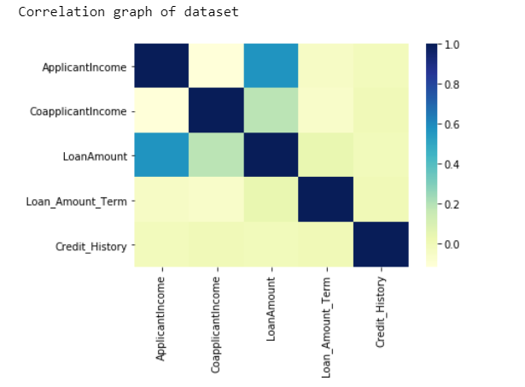
Results
The correlation graph shows that the loan amount is highly correlated with the applicant's income and the co-applicant’s income. If these numbers increase, it will also change the loan amount number.

Slide 10
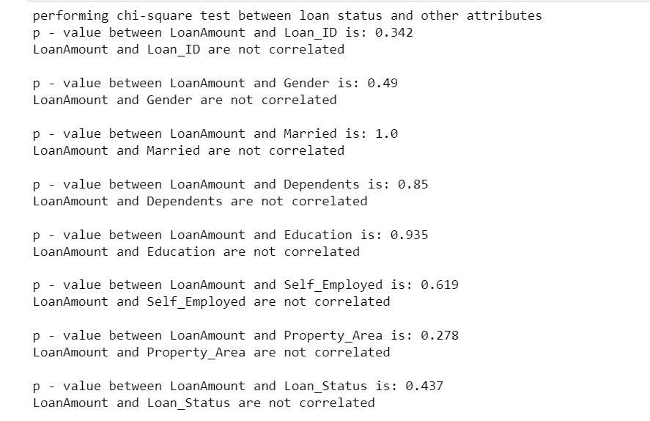
Results
Chi-square Test:
The chi-square test is used to determine if category variables are related.
The difference between predicted and observed frequencies in one or more categories of the frequency table is used to compute it.
Small p-values (less than 5%) generally indicate a substantial difference.

Slide 11
References
[1] Dosalwar, Sharayu & Kinkar, Ketki & Sannat, Rahul & Pise, Nitin. (2021). Analysis of Loan Availability using Machine Learning Techniques. International Journal of Advanced Research in Science, Communication and Technology. 15-20. 10.48175/IJARSCT-1895.
[2]. Sheikh MA, Goel AK, Kumar T. An Approach for Prediction of Loan Approval using Machine Learning Algorithm. In2020 International Conference on Electronics and Sustainable Communication Systems (ICESC) 2020 Jul 2 (pp.490-494).
[3]. Vaidya A. Predictive and probabilistic approach using logistic regression: application to prediction of loan approval. In2017 8th International Conference on Computing, Communication and Networking Technologies (ICCCNT) 2017 Jul 3 (pp.1-6).
[4]. TejaswiniJ, Kavya TM, Ramya RD, Triveni PS, Maddumala VR. Accurate Loan Approval Prediction Based On Machine Learning Approach. Journal of Engineering Science. 2020 Apr;11(4):523-32.

Slide 12

Thank You

